Slide 1

Audio Genre Classification And Virtualization
002839146 Yifan Wang
002839771 Qiwen Ding
002697053 Shuyue Li

Slide 2
Background and Motivation
Enhancing Music Experience
Music visualization can transform auditory experiences into visual ones, providing users with a richer and more immersive music enjoyment.
Improving Music Retrieval Efficiency
Music visualization and artificial intelligence technologies can automatically identify music features (such as rhythm, melody, harmony) for classification, allowing users to find the music they want to listen to more quickly.
Notes:
For example, dynamic visualizations that synchronize music beats with visual elements can increase audience engagement and enjoyment in live performances or music videos.
2. Most people without musical training may not be able to differentiate between different genres of music; they mostly listen based on feeling. The purpose of our project is to visualize their playlists, ultimately enabling them to quantitatively understand what types of music they like so that they can purposefully search for their favorite songs in music listening apps in the future.

Slide 3
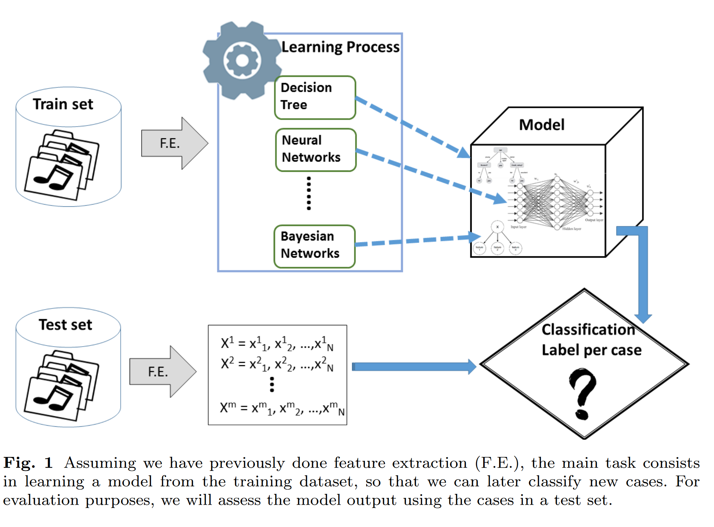
Related Works
Ramírez J, Flores M J. Machine learning for music genre: multifaceted review and experimentation with audioset[J]. Journal of Intelligent Information Systems, 2020, 55(3): 469-499.

Slide 4
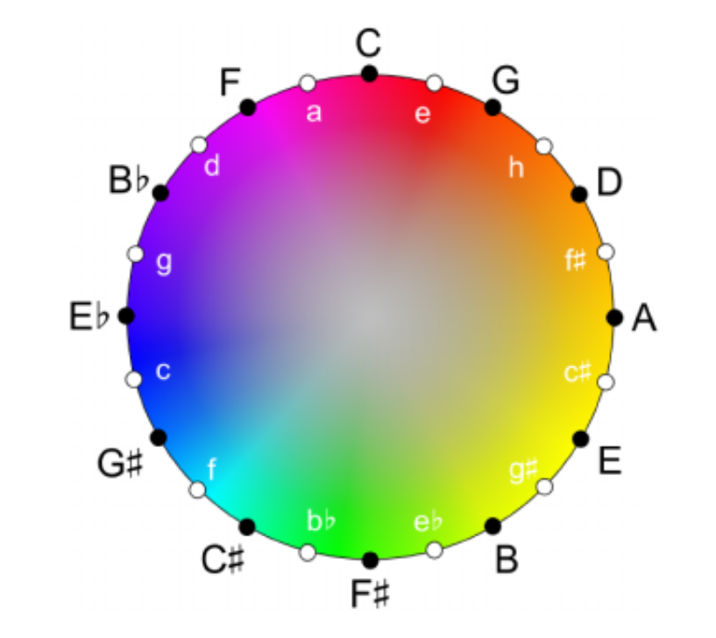
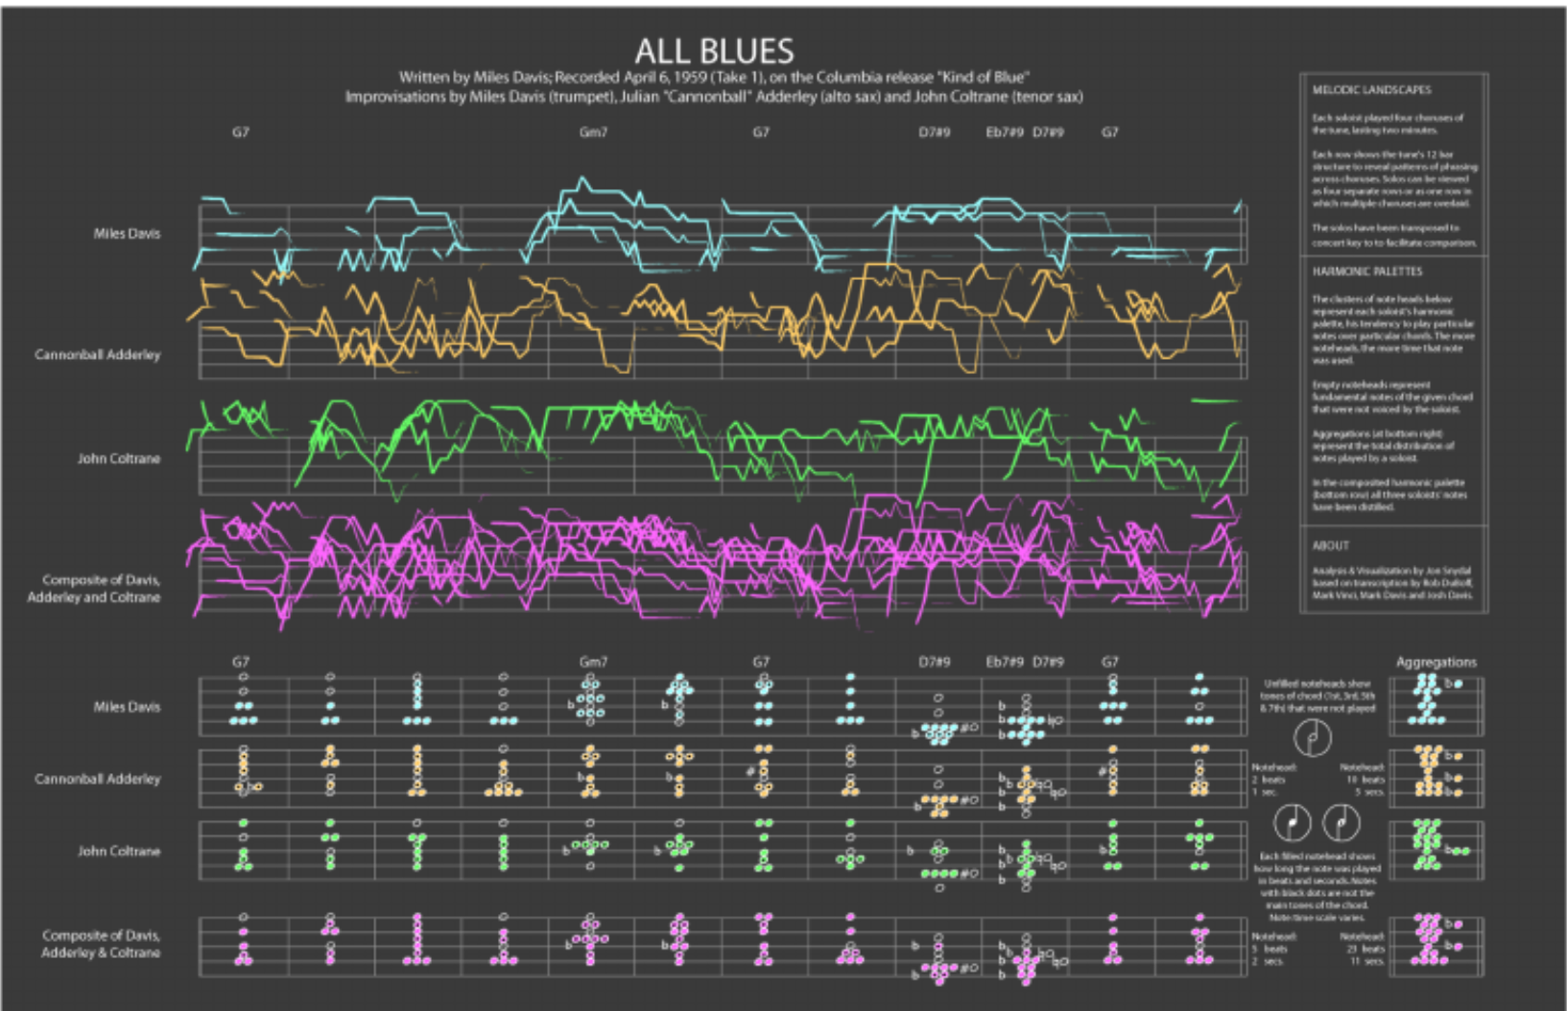
Related Works
Lima H B, Santos C G R D, Meiguins B S. A survey of music visualization techniques[J]. ACM Computing Surveys (CSUR), 2021, 54(7): 1-29.

Slide 5
Data
• Select some datasets about music tracks covering various genres, tempos, and instruments.
GTZAN Genre Collection: This dataset contains 1,000 different songs, distributed across 10 different genres, with 100 songs per genre. Each song is approximately 30 seconds long.
https://www.kaggle.com/datasets/carlthome/gtzan-genre-collection
Extract audio features using digital signal processing techniques or audio analysis libraries (e.g., LibROSA for Python).

Slide 6
Main Work
- Implementation of advanced neural network models for accurate genre classification of audio tracks.
- Integration of web technologies to host the audio visualization and classification platform.
- Development of user-friendly interface through frontend technologies for seamless user experience.

Slide 7
Neural Networks in Audio Processing
- Convolutional Neural Networks (CNNs) are commonly used in audio processing for feature extraction, capturing the temporal patterns in sound waves.
- Recurrent Neural Networks (RNNs) are effective for audio sequence modeling, handling time-series data to capture dependencies in audio signals.
In our work, we decide to use CNNs network to finish the classification.

Slide 8
Methodology - Feature Selection
Identify key musical elements for visualization, such as tempo, pitch, volume (dynamics), and timbre (instrumentation).
Determine how to visually represent each element (e.g., color for timbre, vertical movement for pitch).

Slide 9
Methodology - Visualization Design
Design dynamic visual elements that change in real-time with the music. For example, use circles that expand and contract with volume, lines that move up and down for pitch, and colors that shift based on the instrument being played.
Ensure the visualization is intuitive and accessible to those without a deep understanding of music theory.

Slide 10
Methodology - Technology Stack
Utilize web technologies for interactive visualization (e.g., D3.js, Three.js for 3D visualizations, or p5.js for creative coding).
Employ audio processing libraries (e.g., LibROSA for Python) for feature extraction.
Consider using a web framework (e.g., React or Vue) to create a user-friendly interface.

Slide 11
Methodology - Implementation
Develop a web application that allows users to upload their music files or select from a pre-defined library.
Process the audio in real-time to extract musical features and map these to the visual elements designed.
Ensure the application is responsive and can handle various file sizes and formats efficiently.

Slide 12
Demo website function
We will have two main part of the whole system
One part is to show the virtualization of a song, just like the related works showing
Another part is to use the network to do the classification, while the user can give a whole list of songs, then the website will use network to add labels for each songs, and then the user can see the virtualization of the categories of his song list

Slide 13
Expected Outcomes
A fully functional interactive web application that visualizes music in real-time.
A user-friendly interface that allows users to upload and select music for visualization.
A documentation report detailing the project's development process, challenges encountered, and solutions implemented.

Slide 14


Expected rendering

Slide 15
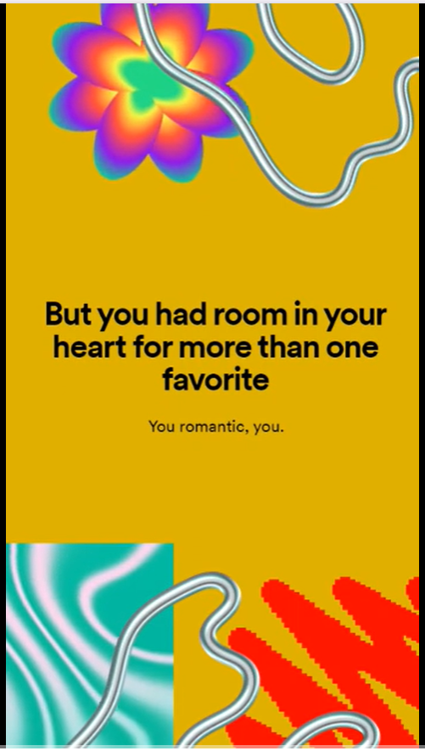
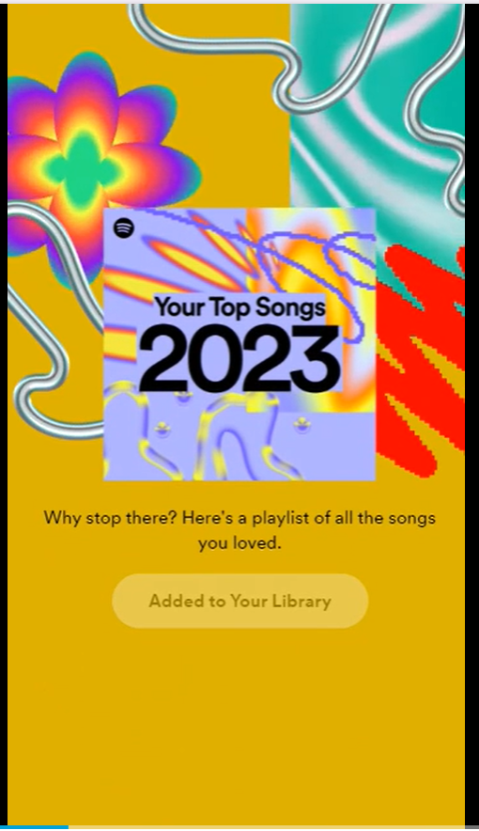


Slide 16
Potential Challenges
Ensuring accurate synchronization between audio and visual elements in real-time.
Designing visualizations that are universally intuitive and engaging.
Handling a wide range of audio features and mapping them effectively to visual representations.

Slide 17
Thank you!

